Slide 1
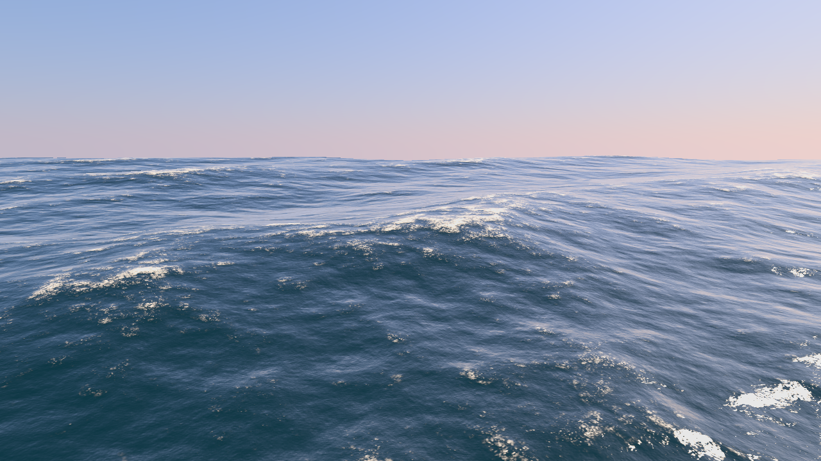
Ocean Surface Generation and Rendering
Thomas Gamper
Research Division of Computer Graphics
Institute of Visual Computing & Human-Centered Technology
TU Wien, Austria

Slide 2
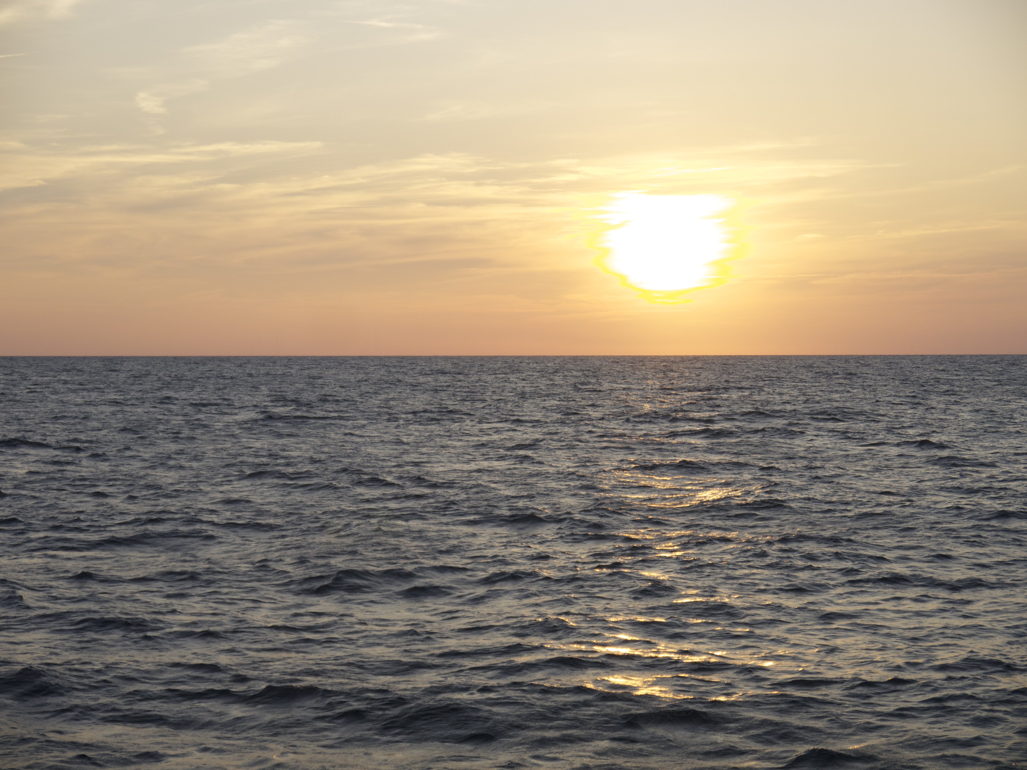
Motivation
Notes:
Sunset over the ocean.

Slide 3
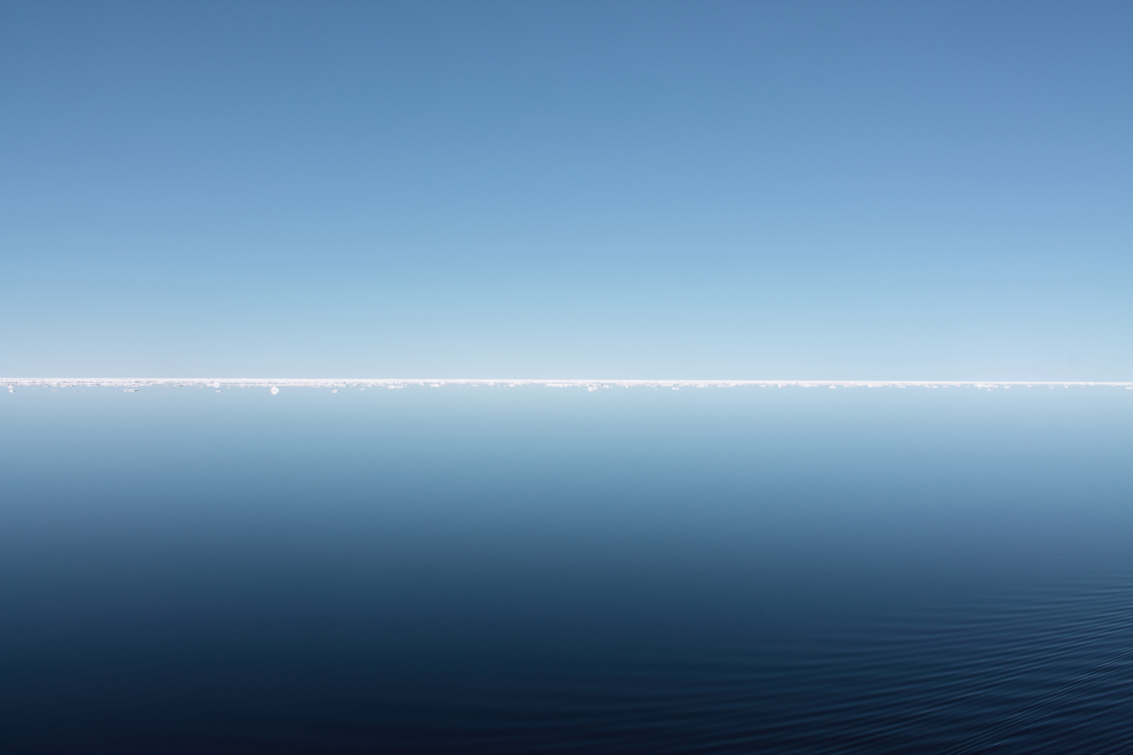
Motivation
Notes:
Perfectly calm arctic sea.

Slide 4
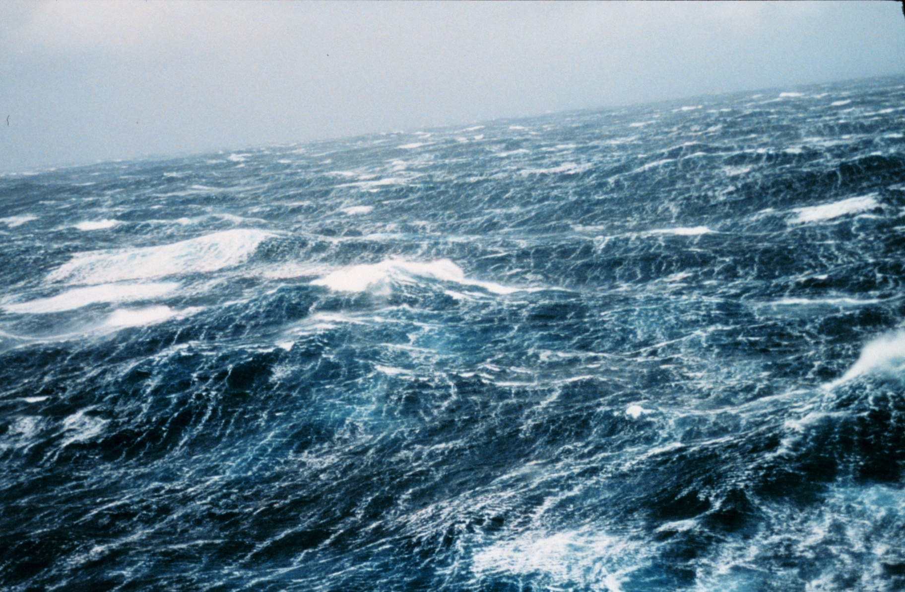
Motivation
Notes:
Storm waves.

Slide 5
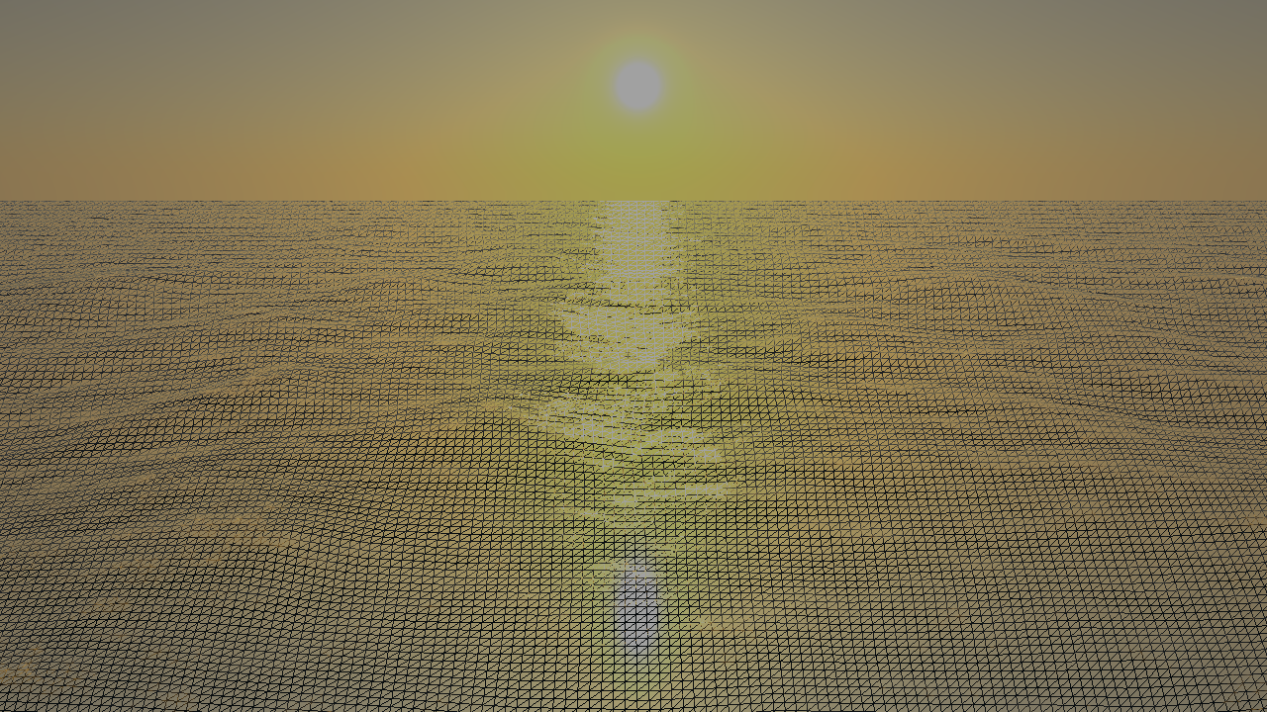
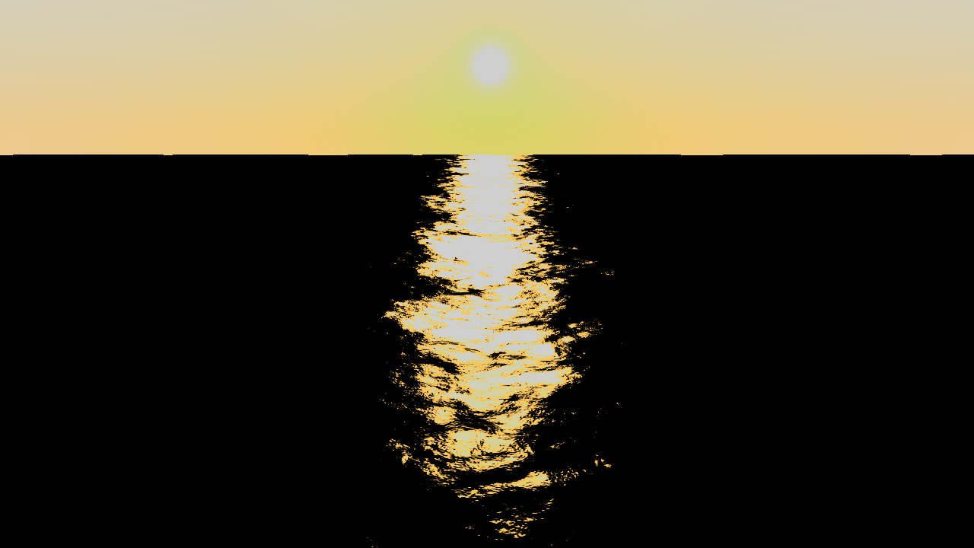
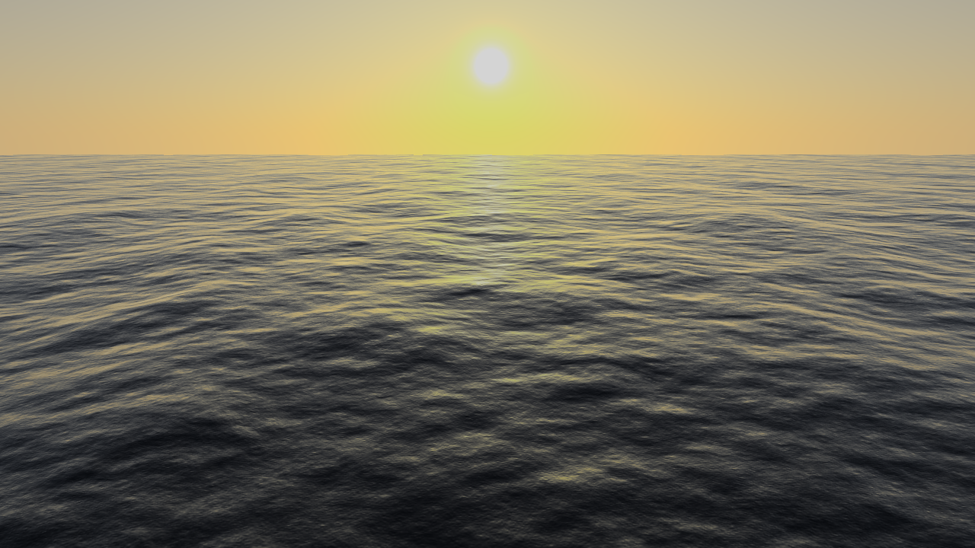
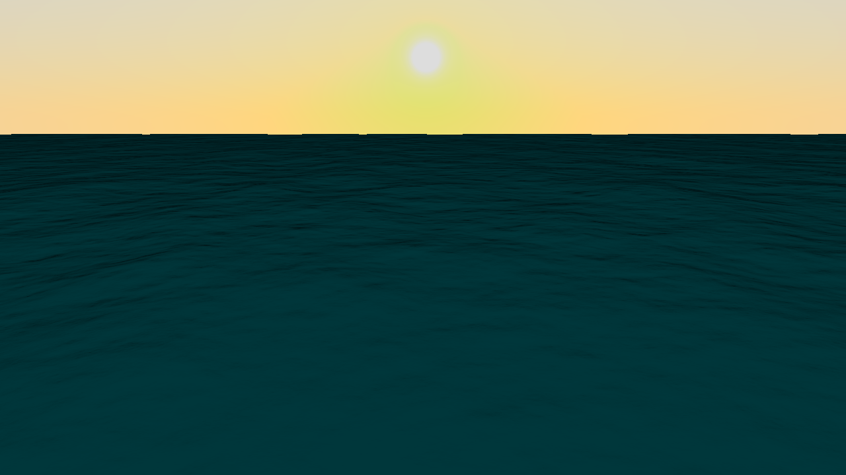
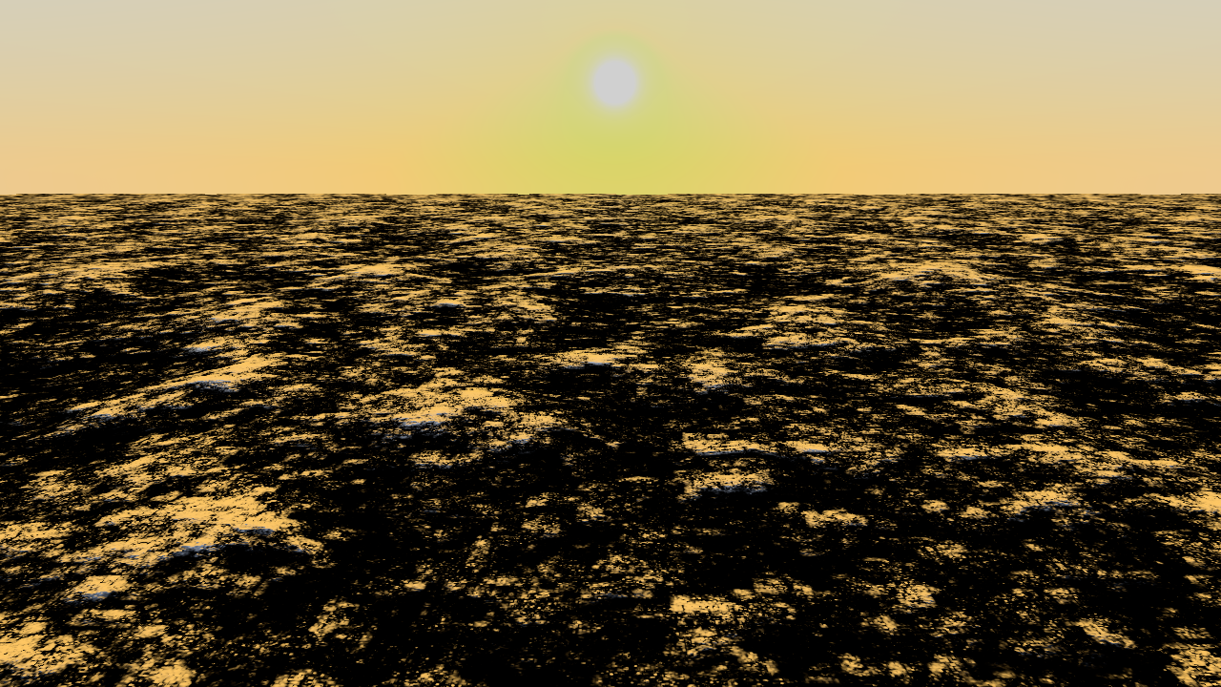
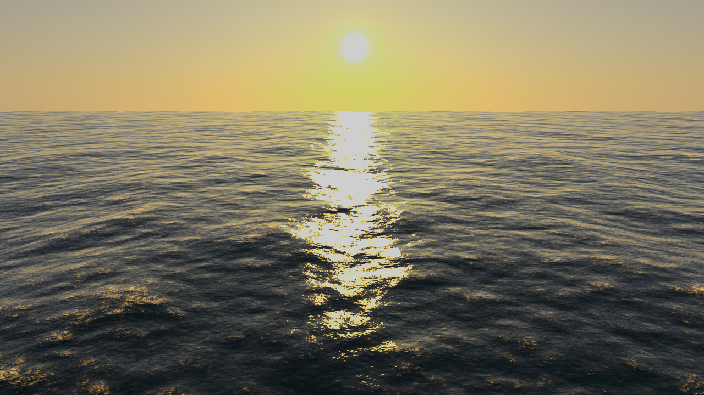
Related Work
Choppy wave algorithm [Tessendorf1999]
Employs wave spectrum concept from oceanography
Adapted for real-time operation [Brunetone2010, Dupuy2012, Johanson2004]

Slide 6
Problems
Choice of wave spectrum
Many distinct models
Which ones to use?
Performance
Surface synthesis
Level of detail

Slide 7
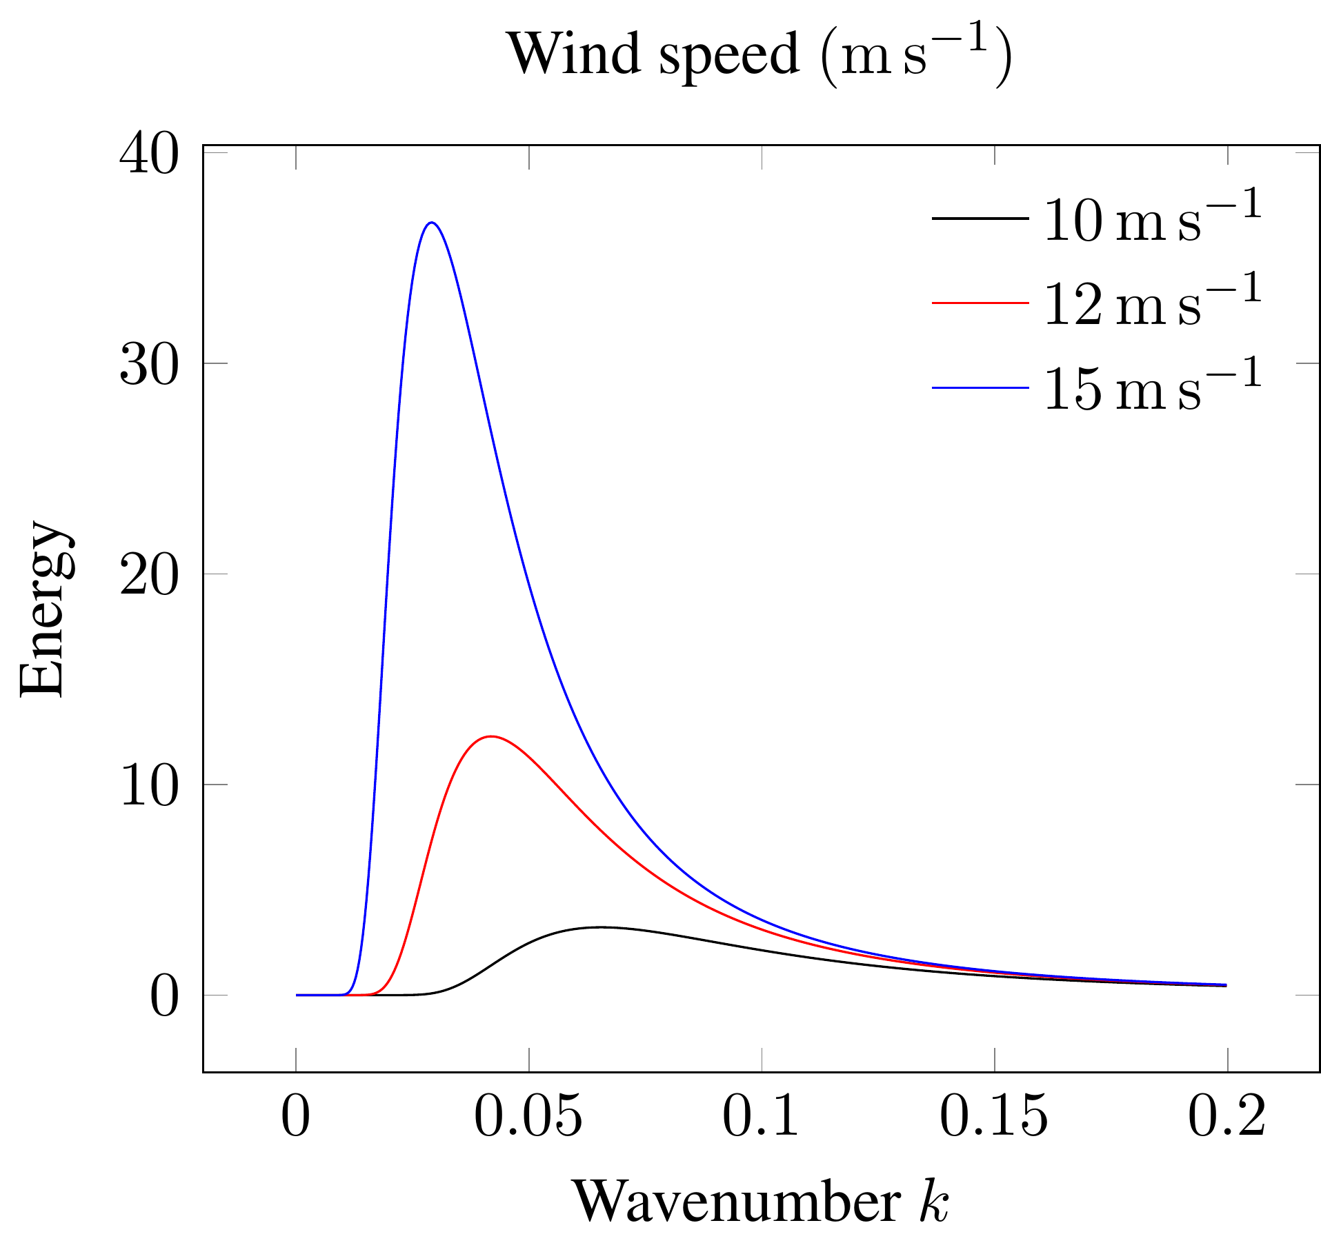
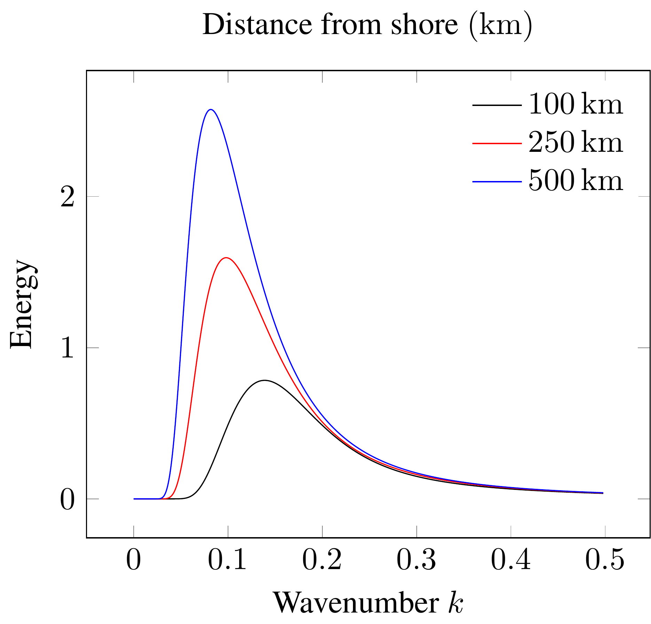
The wave spectrum
Notes:
The wave spectrum describes the distribution of energy among waves.

Slide 8
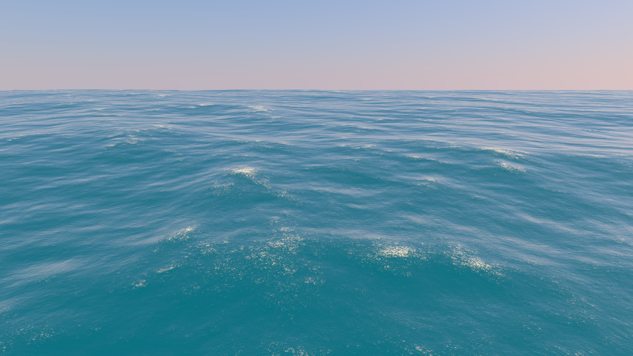
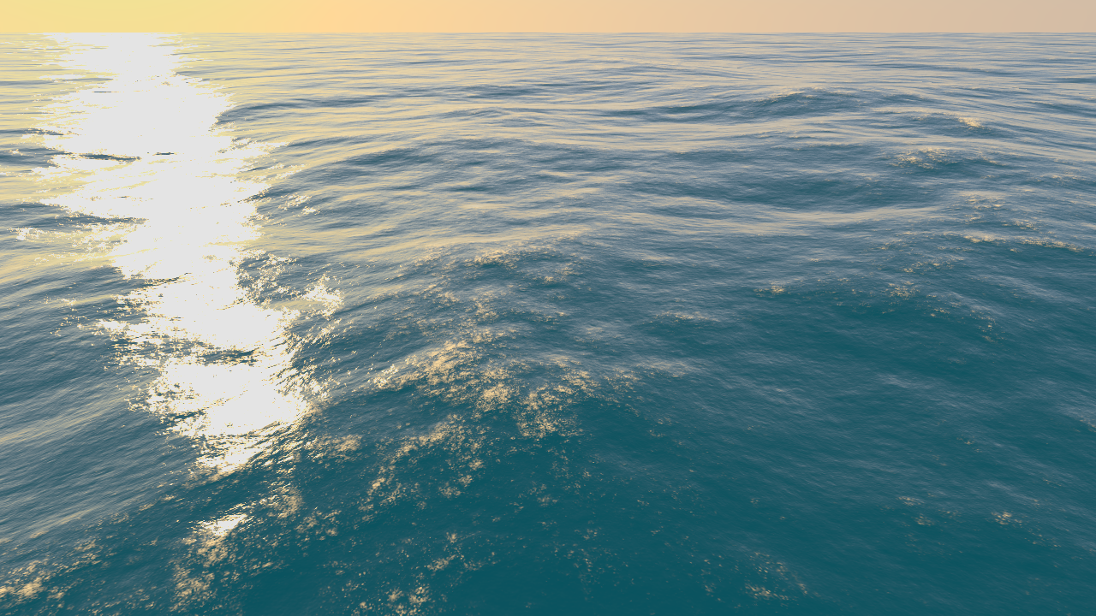
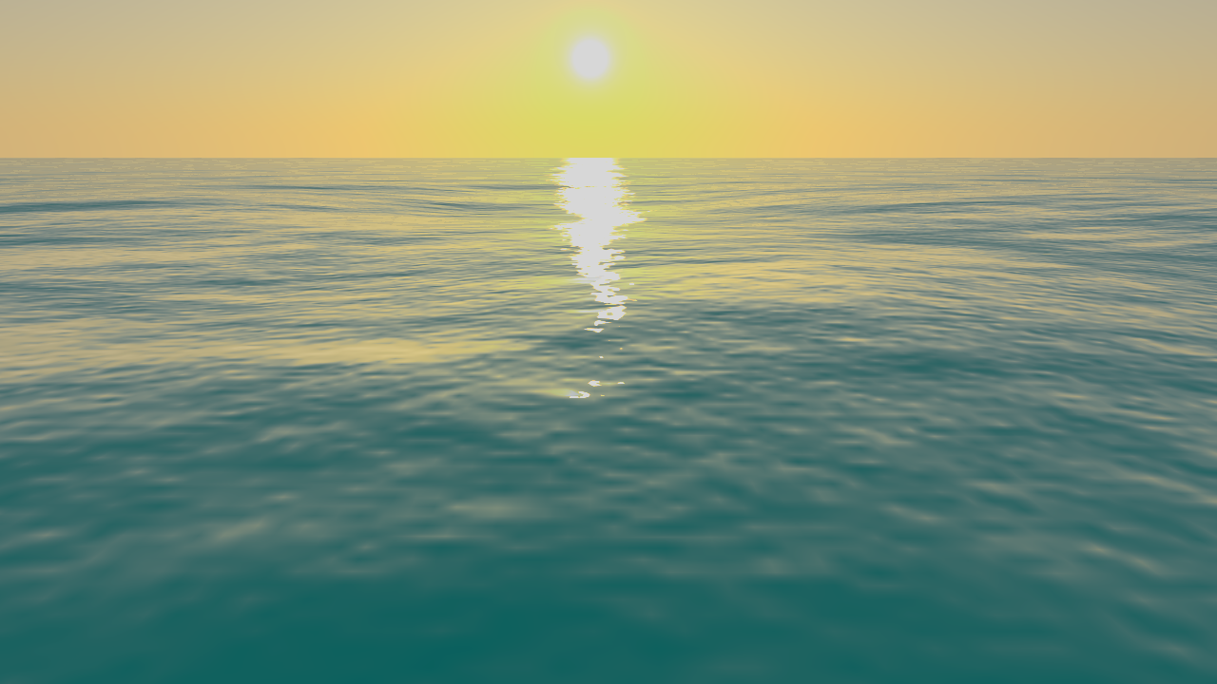
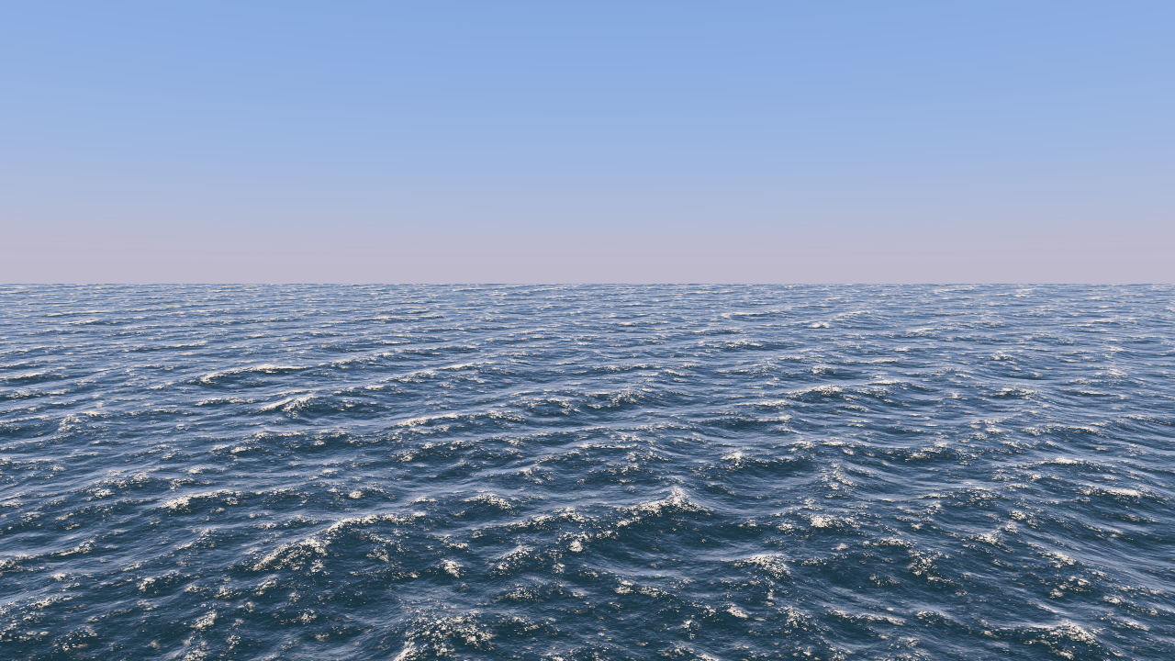

Wave spectrum models
Pierson-Moskowitz
Unified
JONSWAP

Slide 9
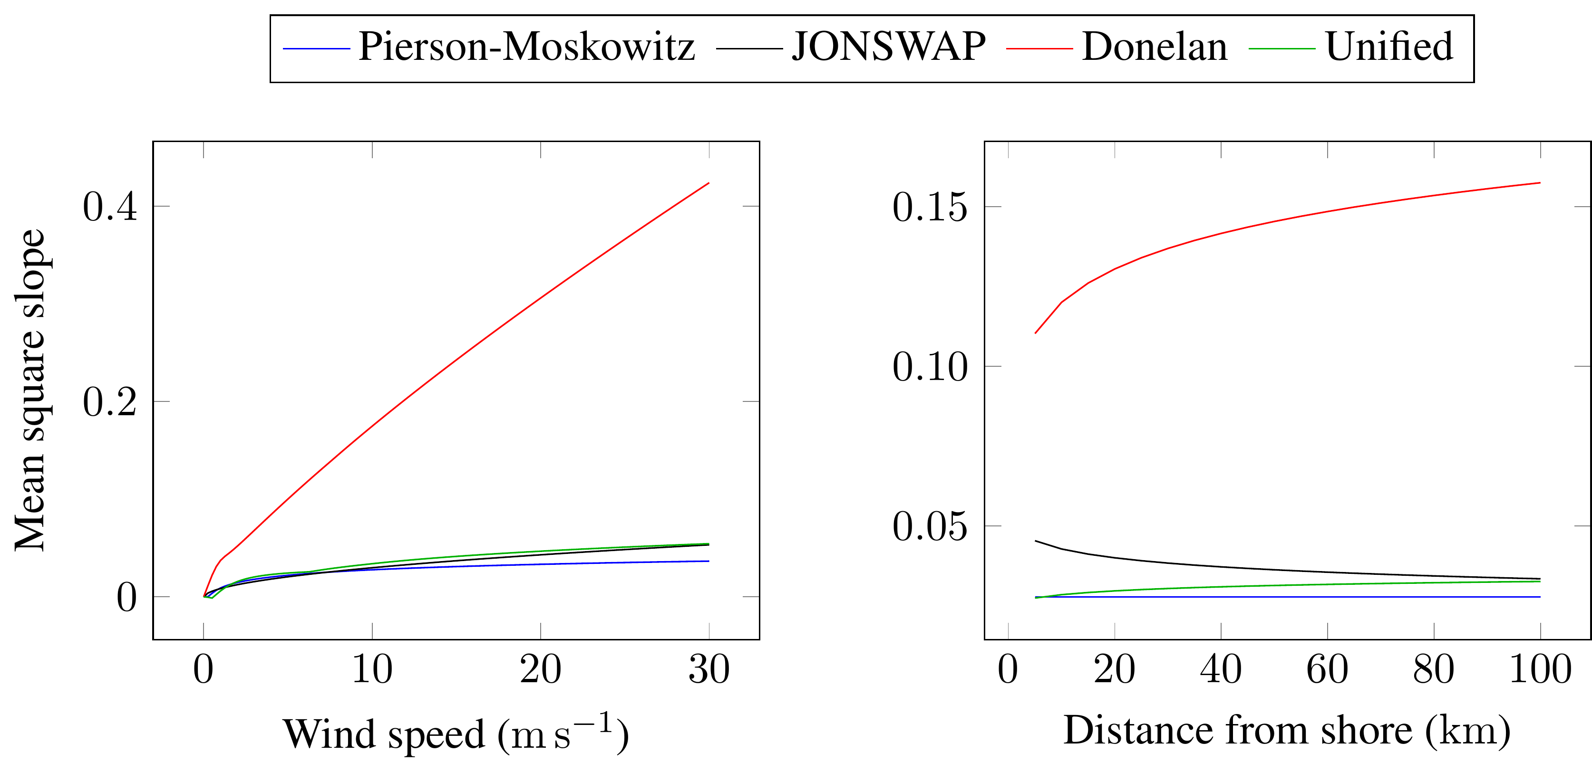
Donelan spectrum lighting issue
Notes:
Lighting algorithm is based on the mean square slope. The mean square slope is a measure for the surface’s roughness. Donelan severely overestimates mss, thus lighting is broken.

Slide 10
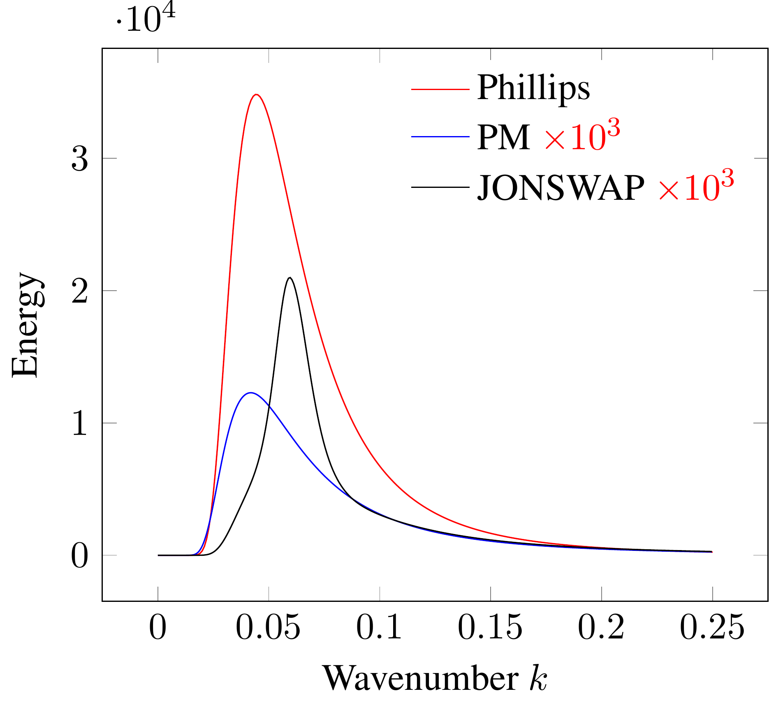
Phillips spectrum
Unqualified
Notes:
Phillips spectrum’s scale is off the charts. Only usable with additional scaling parameters.

Slide 11
Wave spectra
From oceanography
Pierson Moskowitz
JONSWAP
Donelan
Elfouhaily
From computer graphics
Phillips

Slide 12
Pierson Moskowitz
For gentle seas
Works flawlessly with [Bruneton2010]

Slide 13
JONSWAP
For turbulent seas
Issues with [Bruneton2010] at low fetch

Slide 14
Donelan
For turbulent and semi-turbulent seas
Breaks down with [Bruneton2010]

Slide 15
Elfouhaily
Between gentle and turbulent seas
Best for closeups
Works flawlessly with [Bruneton2010]

Slide 16
Tessendorf
Disqualified

Slide 17
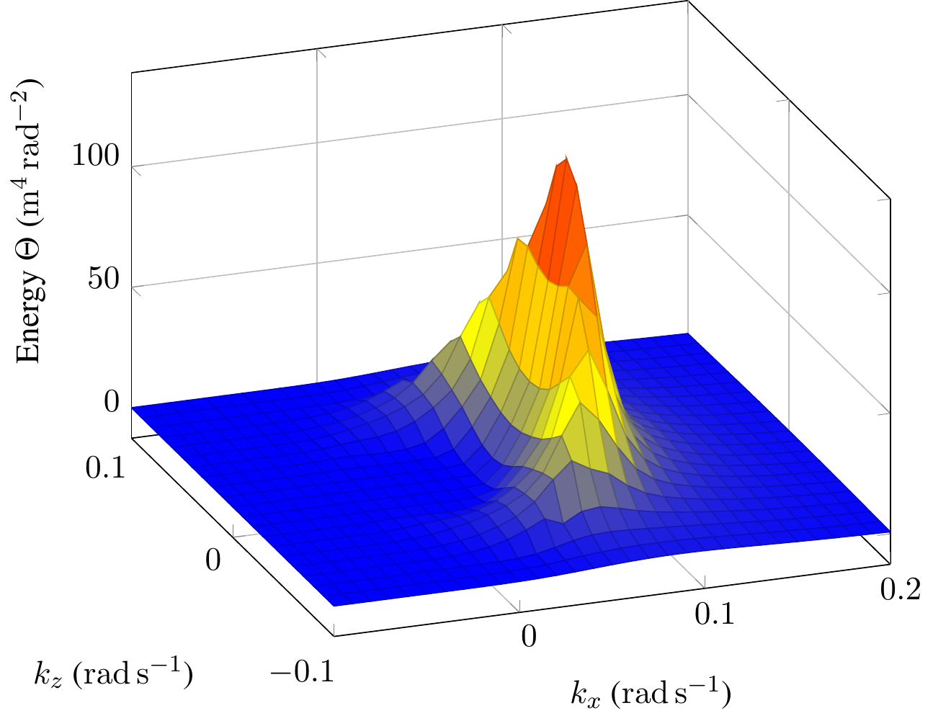
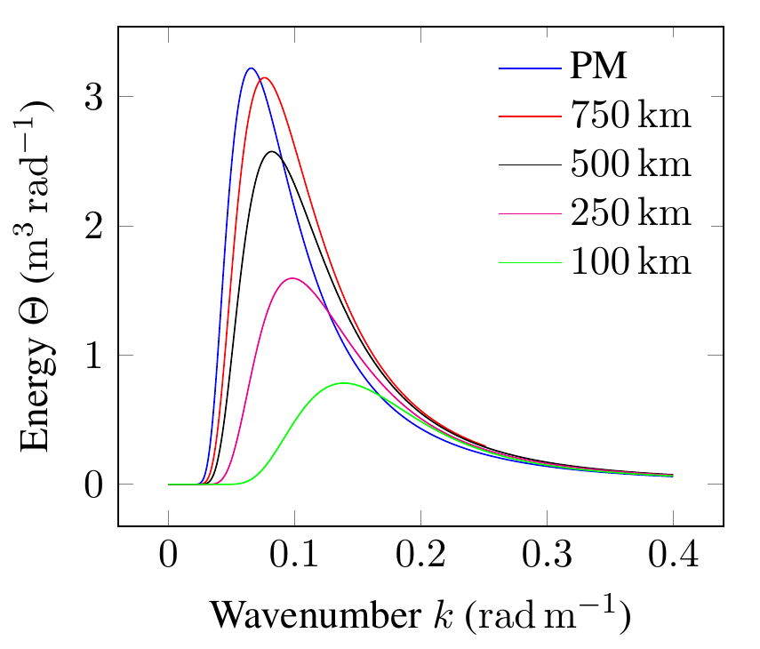
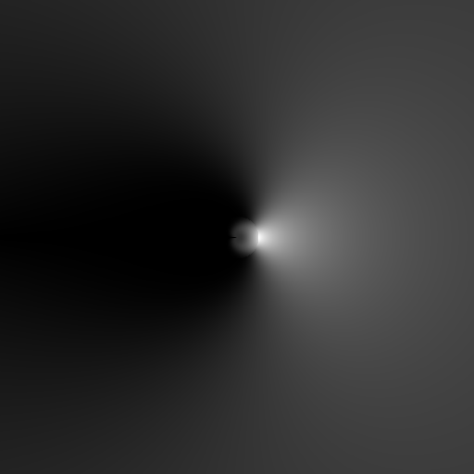
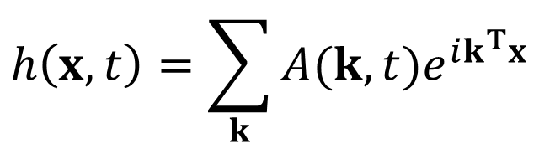
Wave spectrum
$$h\left(x,t\right)=\sum_{k}{A(k,t)e^{ik^{T}x}}$$

Slide 18
Evaluated wave spectra (1/2)
Pierson Moskowitz
Works best for gentle seas
Awesome with lighting
JONSWAP
Suitable for agitated seas
Works well with lighting, except low fetch conditions
Donelan
Suitable for all kinds of sea
Lighting is a disaster

Slide 19
Evaluated wave spectra (2/2)
Unified
For all seas between PM and JONSWAP
Good with small wavelengths -> closeups
Works flawlessly with lighting
Tessendorf
Geometry is a disaster, no further analysis

Slide 20
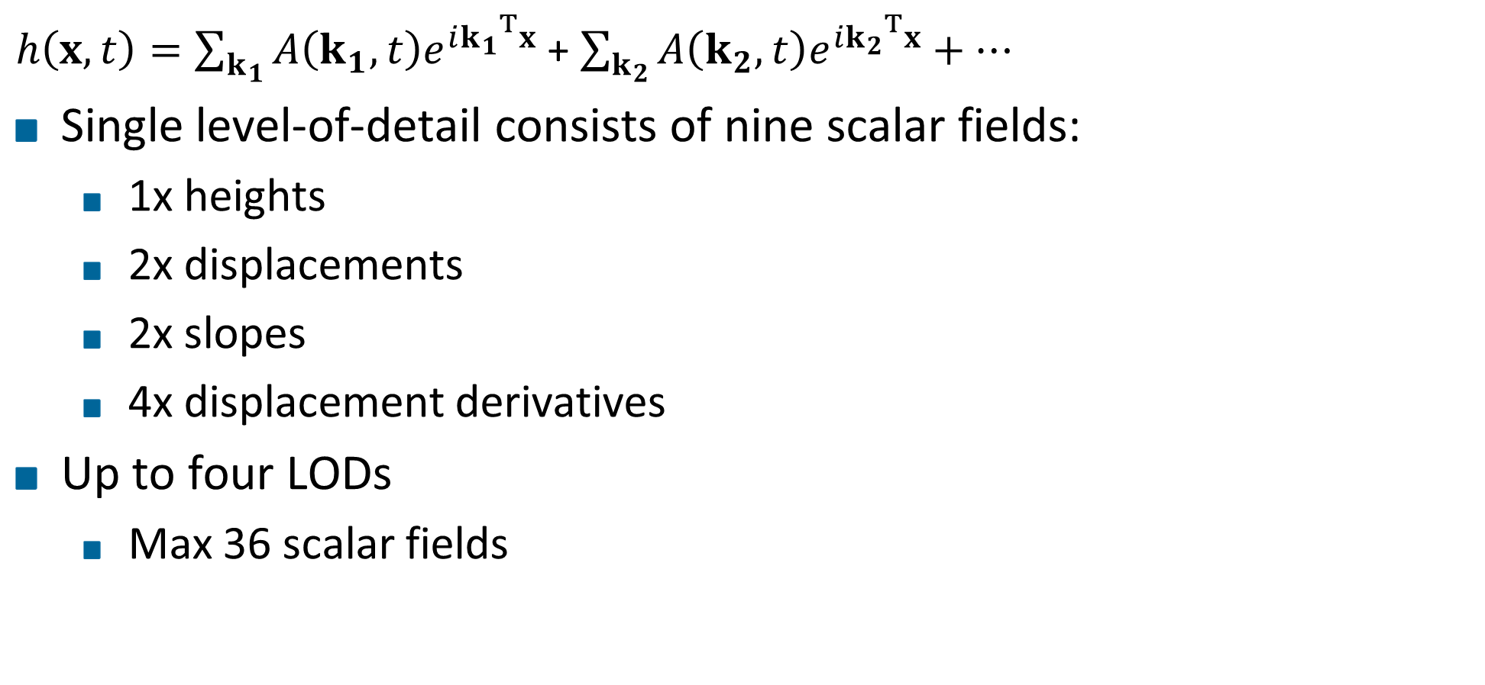
Level of detail
$h\left(x,t\right)=\sum_{k_{1}}{A\left(k_{1},t\right)e^{i{k_{1}}^{T}x}}$ + $\sum_{k_{2}}{A\left(k_{2},t\right)e^{i{k_{2}}^{T}x}}+…$
Single level-of-detail consists of nine scalar fields:
1x heights
2x displacements
2x slopes
4x displacement derivatives
Up to four LODs
Max 36 scalar fields

Slide 21
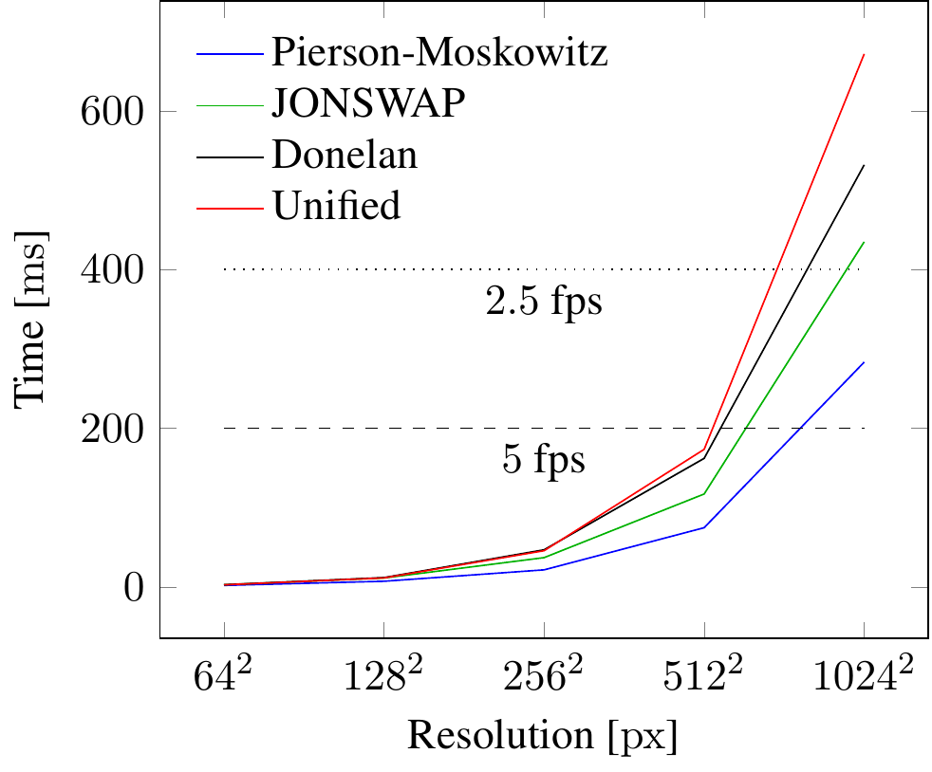
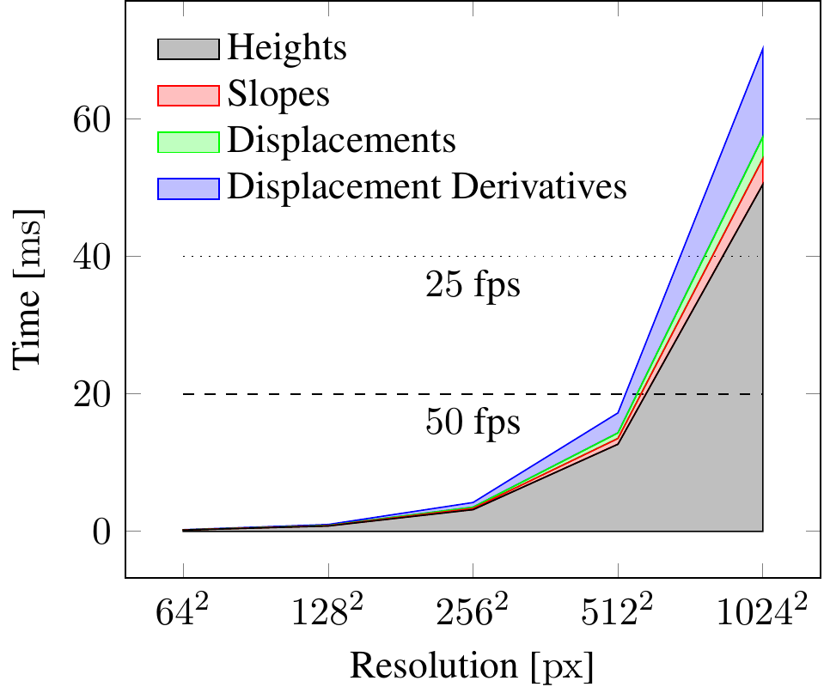
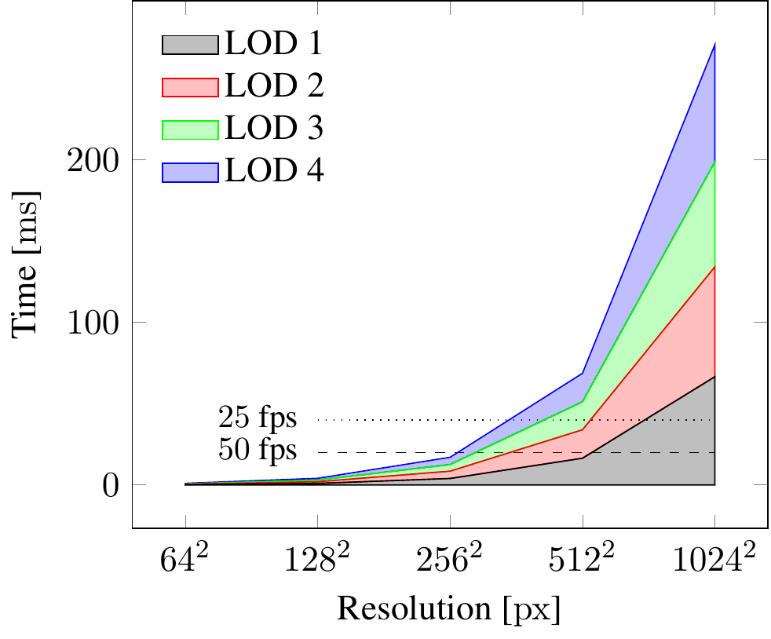
Performance LOD generation

Slide 22
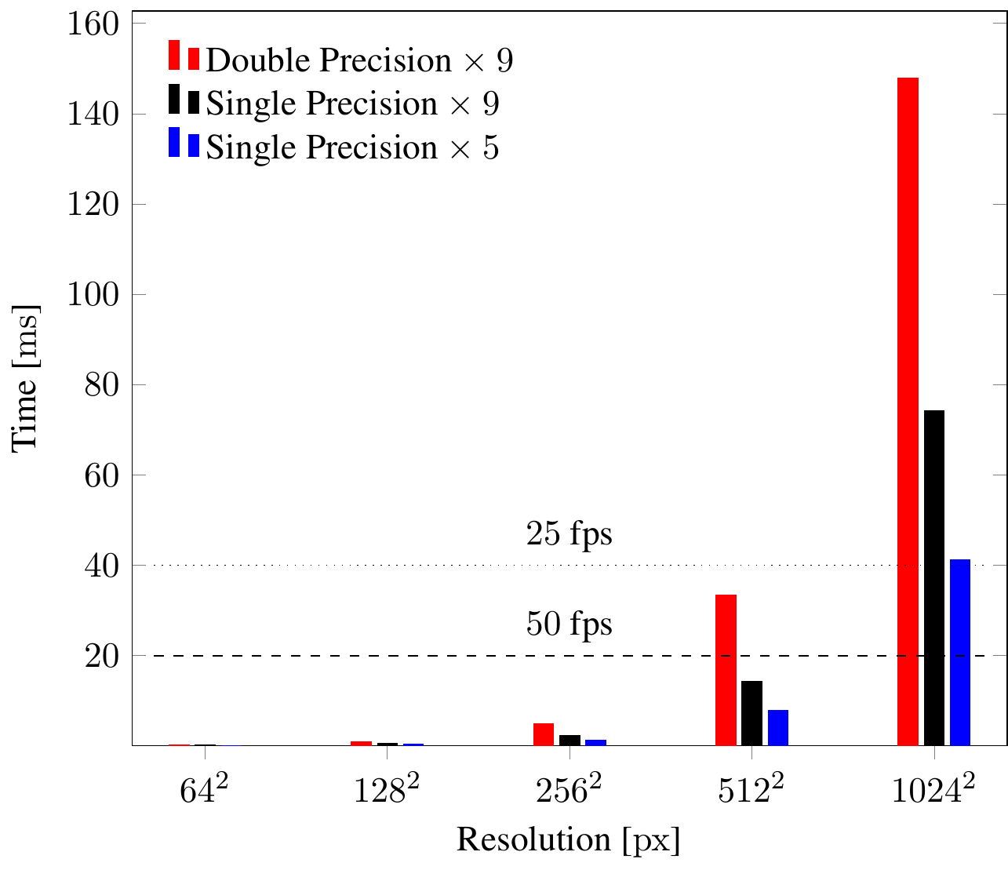
Performance FFT
Pack nine scalar fields into 5

Slide 23
Multi-Res
Support two distinct resolutions
Heights and displacements
Slopes and displacement derivatives
Only up to 10% gain for generation
Speedup in FFT up to 40% because low-res FFT basically negligible
Further improvements down the line because less data to transfer and to process

Slide 24
Video

Slide 25
Summary
Contribution 1: implement and evaluate wave energy models
Pierson-Moskowitz and Unified work well in all conditions
JONSWAP works well in most conditions, except low-fetch
Donelan and Tessendorf disqualified
Contribution 2: multi-resolution level-of-detail
Allows for more fine-grained balance between model detail and performance

Slide 26
Thank You for your Attention!

Slide 27
Future Work

Slide 28
Motivation
Challenges:
Ocean is dynamic and complex
Closeups and views to the horizon
Lighting
Notes:
Generation, animation and rendering of the surface of an open ocean in real time.

Slide 29
Headline
Level 0
Level 1
Level 2
Hint: Do NOT use bullet lists wherever possible !!!

Slide 31
Sometimes a dark background is better. Use this template.

Slide 32
Thank You for your Attention!
Don't forget to include a last slide that contains teaser images or a video or something else that reminds people about what you said.
It might well be that this slide will be on the screen during the whole discussion!

